Slide 1






Upgrading from .NET Framework to .NET 6
Isaac Levin
Principal Product Marketing Manager
@isaacrlevin

Slide 2
Why .NET 6
Single SDK, one BCL, unified toolchain
Cross-platform native UI
Cross-platform web UI
Cloud native investments
Performance & productivity improvements
.NET
.NET has the best of breed solutions for all modern workloads
In a single, unified development platform
Notes:
Preparation: Review dependencies and run API Portability Analyzer
NuGet packages, loose binaries, front-end dependencies, .NET Framework APIs used
Upgrade: Run the .NET Upgrade Assistant with your solution
Fix code and build: Head back to Visual Studio and attempt to build your code.
Look for warnings in the Error List window of Visual Studio to help you identify other parts of your code that might not be supported in .NET 6.
Check any NuGet packages that might have been updated for any potential breaking changes.
Likely additional code updates will be required for your app’s business logic.
Run and test: There might be changes that aren’t apparent until runtime. Test that everything works as expected.
Testing is important because some changes won’t be apparent until runtime.
Unit test projects should be ported along with the target project.
If NuGet package versions updated, for example, there could be subtle breaking changes.

Slide 3
One .NET vision
– .NET 6 "wave"
.NET Framework
Single SDK, one BCL, unified toolchain
Cross-platform native UI
Cross-platform web UI
Cloud native investments
Continue improvements in speed, size, diagnostics, Azure services
.NET Core
.NET
Mono / Xamarin
.NET has the best of breed solutions for all modern workloads

Slide 4
What does this actually mean?
No more features, only fixes
.NET Framework 4.8
.NET Core 3.1
.NET Core 4.0
.NET 6
.NET 5.0
Mono / Xamarin

Slide 5
What is not in .NET 6?
AppDomains, remoting, Web forms, WCF server and Windows workflow remain on .NET Framework 4.8 only.
There are no plans to port these.
Component | Replacement
AppDomains | AssemblyLoadContext
Remoting | named pipes gRPC
WebForms | ASP.NET Blazor
WCF Server | gRPC Open source community project: https://github.com/CoreWCF/CoreWCF
WF | Open source community project: https://github.com/UiPath/corewf

Slide 6
Simplified framework names in .NET 6
net6.0. This is for code that runs everywhere. It combines and replaces the netcoreapp and netstandard names.
net6.0-windows (and for devices net6.0-android and net6.0-ios). These TFMs represent OS-specific flavors of .NET 6 that include net6.0 plus OS-specific functionality.
netX.Y-windows
netX.Y-android
netX.Y-ios
netX.Y-<os>
netX.Y
netcoreapp3.1
netstandard2.1

Slide 7

What will Microsoft libraries target?
Area | Target Framework
Cross Platform Libraries ASP.NET Core, EF, virtually all System.* packages, most libraries | net6.0
Windows Controls WinForms-, WPF-, and (managed) UWP controls | net6.0-windows
Cross Platform Abstractions Xamarin Essentials, Xamarin Forms, MAUI, or any other cross-platform abstraction | net6.0 And each OS-specific framework that it provides implementations for
Cross Platform Libraries for .NET Framework Azure SDK, Microsoft.Data.SqlClient and other packages that need to support .NET Framework | netstandard2.0

Slide 8

What should you target?
Continue to use netstandard2.0 to share code between .NET Framework and all other platforms.
Consider using netstandard2.1 to share code between Mono, Xamarin, and .NET Core 3.x (less relevant with .NET 6).
Use net6.0 for code sharing moving forward.

Slide 9
Typical workflow
Preparation: Review dependencies
NuGet packages, loose binaries, front-end dependencies, .NET Framework APIs used
Tools: .NET Upgrade Assistant analyze , API Portability Analyzer
Upgrade: Run the .NET Upgrade Assistant upgrade command with your solution / project.
Fix code and build: Head back to Visual Studio and attempt to build your code.
Look for warnings in the Error List, check any NuGet packages that were updated and expect to make additional changes to your code.
Run and test: There might be changes that aren’t apparent until runtime. Test that everything works as expected.
Notes:
Preparation: Review dependencies and run API Portability Analyzer
NuGet packages, loose binaries, front-end dependencies, .NET Framework APIs used
Upgrade: Run the .NET Upgrade Assistant with your solution
Fix code and build: Head back to Visual Studio and attempt to build your code.
Look for warnings in the Error List window of Visual Studio to help you identify other parts of your code that might not be supported in .NET 6.
Check any NuGet packages that might have been updated for any potential breaking changes.
Likely additional code updates will be required for your app’s business logic.
Run and test: There might be changes that aren’t apparent until runtime. Test that everything works as expected.
Testing is important because some changes won’t be apparent until runtime.
Unit test projects should be ported along with the target project.
If NuGet package versions updated, for example, there could be subtle breaking changes.

Slide 10
Rewrite or reuse?
Reuse
Business logic
Identity data
Dependency injection container configuration
Many third-party dependencies
ASP.NET Controllers, Views, and Models
Rewrite
ASP.NET Startup code
Routing
MVC configuration
Authentication
Error handling
etc.
Configuration
Bundling/minification
HTTP modules
ASP.NET Web Forms
Server WCF
Notes:
Note that “Many third-party dependencies” doesn’t say “All”. Some will need to change.

Slide 11
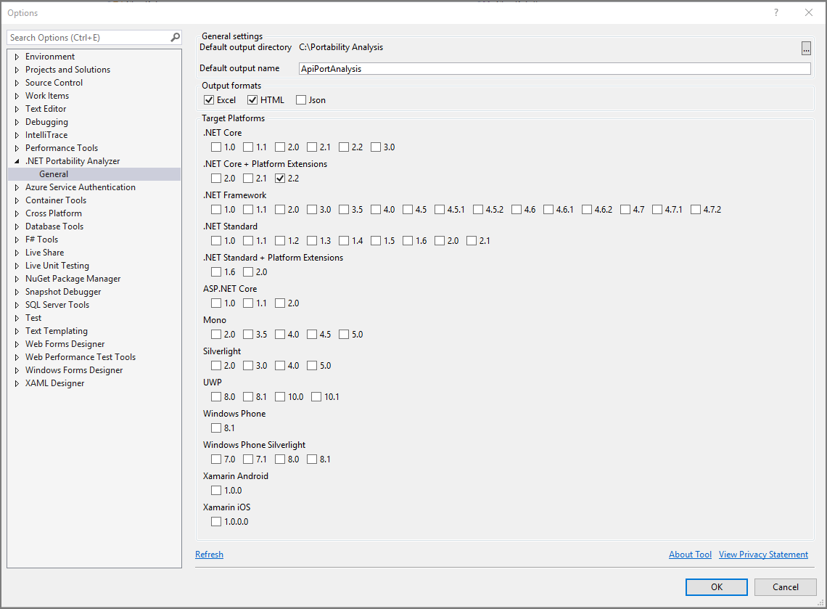
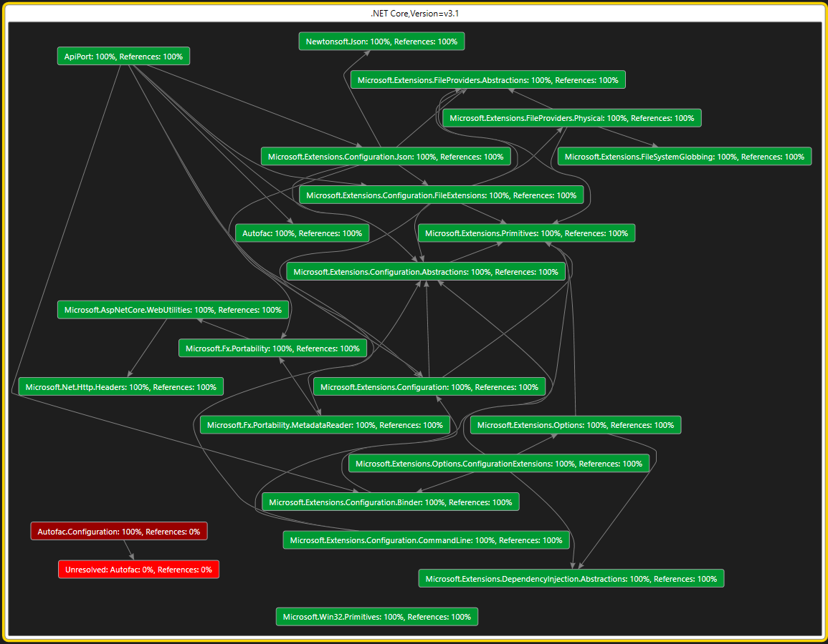
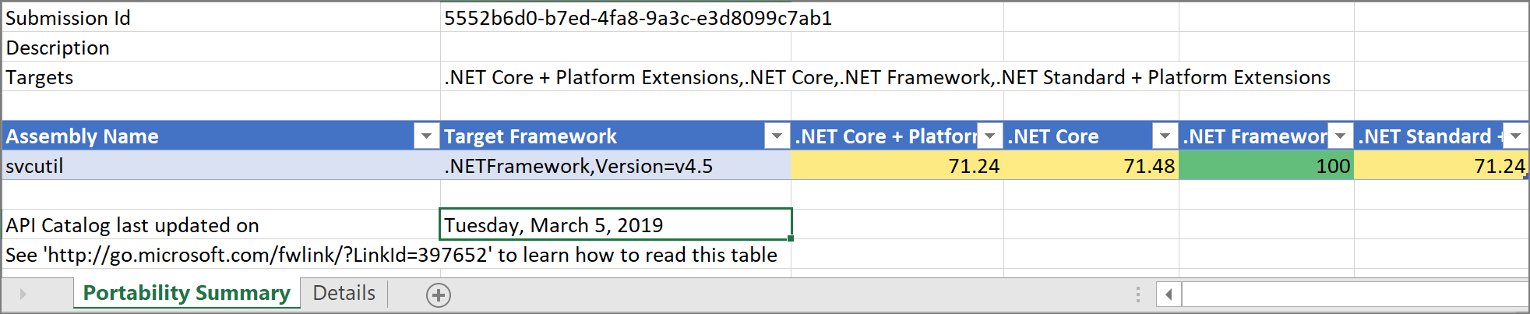
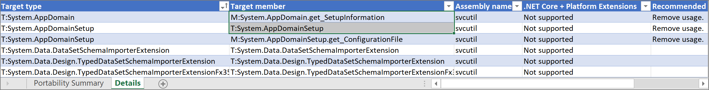
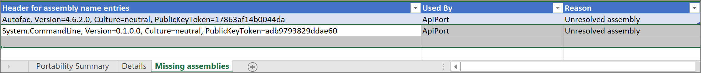
.NET Portability Analyzer
Notes:
Note that “Many third-party dependencies” doesn’t say “All”. Some will need to change.

Slide 12
.NET Upgrade-Assistant
Get the .NET Upgrade Assistant: github.com/dotnet/upgrade-assistant
What’s supported: ASP.NET MVC, WinForms, WPF, console apps and class libraries
Tool functionality
Analyze – Analyzes package dependencies for a project prior to upgrade. An analysis summary is provided for each of the projects in the solution.
Upgrade – Automates many previously manual steps like updating project files to be SDK-style projects, re-target projects to chosen TFM, etc.
Notes:
What it does at a high level – ”I’m going to demo it in just a minute…”
The Upgrade Assistant…enables automation of common tasks related to upgrading .NET Framework projects to .NET 6 and beyond.
Note that this is not a complete upgrade tool and work will be required after using the tooling to upgrade a project.

Slide 13
.NET Upgrade Assistant (cont.)
Unsupported app types
ASP.NET Web Forms
Consider Blazor or Razor pages
Server-side WCF
Consider WebAPI, gRPC, or Core WCF
Remoting
Consider StreamJsonRpc, gRPC, or WebAPI

Slide 14
Demo

Slide 15

Thanks for joining!
http://isaacl.dev/dotnet-upgrade

